Slide 1
Parameter estimation class 6
Multiple View Geometry
Comp 290-089
Marc Pollefeys

Slide 2
Content
Background: Projective geometry (2D, 3D), Parameter estimation, Algorithm evaluation.
Single View: Camera model, Calibration, Single View Geometry.
Two Views: Epipolar Geometry, 3D reconstruction, Computing F, Computing structure, Plane and homographies.
Three Views: Trifocal Tensor, Computing T.
More Views: N-Linearities, Multiple view reconstruction, Bundle adjustment, auto-calibration, Dynamic SfM, Cheirality, Duality

Slide 3
Multiple View Geometry course schedule
(subject to change)
Jan. 7, 9 | Intro & motivation | Projective 2D Geometry
Jan. 14, 16 | (no class) | Projective 2D Geometry
Jan. 21, 23 | Projective 3D Geometry | (no class)
Jan. 28, 30 | Parameter Estimation | Parameter Estimation
Feb. 4, 6 | Algorithm Evaluation | Camera Models
Feb. 11, 13 | Camera Calibration | Single View Geometry
Feb. 18, 20 | Epipolar Geometry | 3D reconstruction
Feb. 25, 27 | Fund. Matrix Comp. | Structure Comp.
Mar. 4, 6 | Planes & Homographies | Trifocal Tensor
Mar. 18, 20 | Three View Reconstruction | Multiple View Geometry
Mar. 25, 27 | MultipleView Reconstruction | Bundle adjustment
Apr. 1, 3 | Auto-Calibration | Papers
Apr. 8, 10 | Dynamic SfM | Papers
Apr. 15, 17 | Cheirality | Papers
Apr. 22, 24 | Duality | Project Demos

Slide 4
Parameter estimation
2D homography
  Given a set of (x_{i},x_{i}’), compute H (x_{i}’=Hx_{i})
3D to 2D camera projection
  Given a set of (X_{i},x_{i}), compute P (x_{i}=PX_{i})
Fundamental matrix
  Given a set of (x_{i},x_{i}’), compute F (x_{i}’^{T}Fx_{i}=0)
Trifocal tensor
  Given a set of (x_{i},x_{i}’,x_{i}”), compute T

Slide 5
DLT algorithm
Objective
Given n≥4 2D to 2D point correspondences {x_{i}↔x_{i}’}, determine the 2D homography matrix H such that x_{i}’=Hx_{i}
Algorithm
For each correspondence x_{i} ↔x_{i}’ compute A_{i}. Usually only two first rows needed.
Assemble n 2x9 matrices A_{i} into a single 2nx9 matrix A
Obtain SVD of A. Solution for h is last column of V
Determine H from h

Slide 6



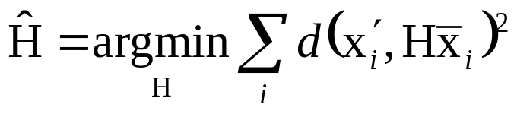
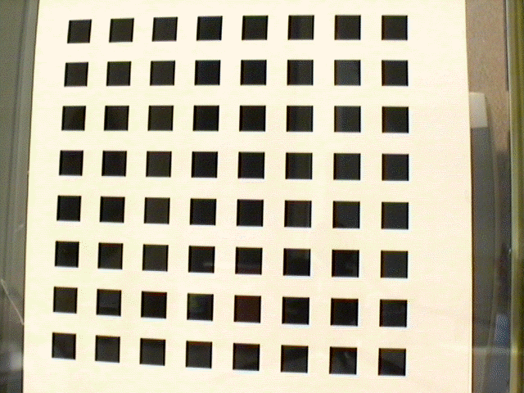
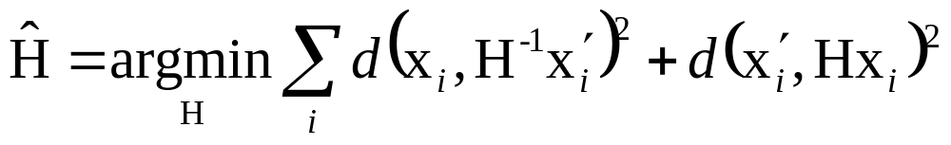
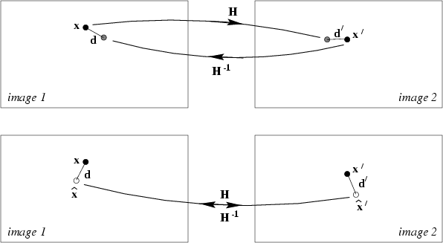
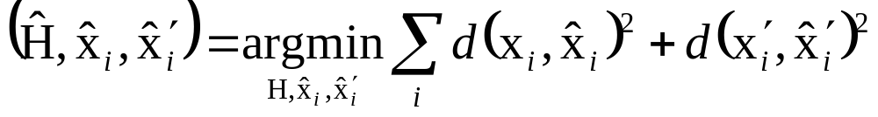
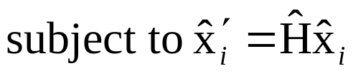
Geometric distance
measured coordinates
estimated coordinates
true coordinates
d(.,.) Euclidean distance (in image)
Error in one image
e.g. calibration pattern
Symmetric transfer error
Reprojection error

Slide 7


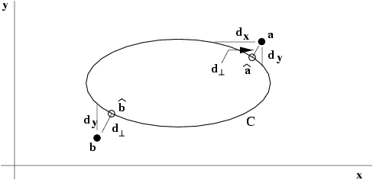


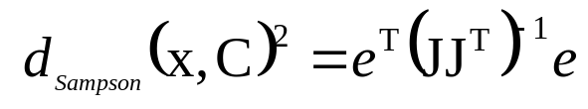
Geometric interpretation of reprojection error
Estimating homography~fit surface to points X=(x,y,x’,y’)^{T} in ⁴
Analog to conic fitting
Notes:
Nonlinear, except for line fitting = affine homographies (no quadratic terms in this case!) (x,x’,y and x,y,y’) => linear solution

Slide 8
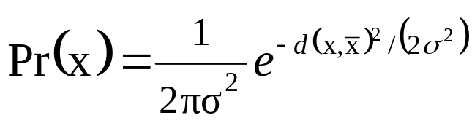
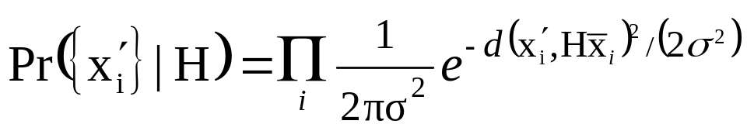

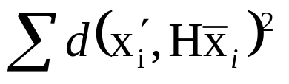
Statistical cost function and Maximum Likelihood Estimation
Optimal cost function related to noise model
Assume zero-mean isotropic Gaussian noise (assume outliers removed)
Error in one image
Maximum Likelihood Estimate

Slide 9
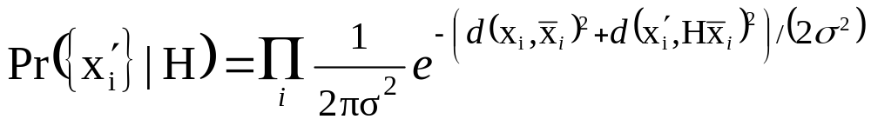
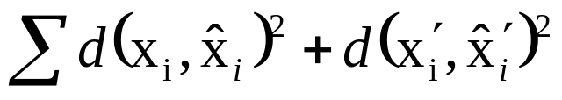
Statistical cost function and Maximum Likelihood Estimation
Optimal cost function related to noise model
Assume zero-mean isotropic Gaussian noise (assume outliers removed)
Error in both images
Maximum Likelihood Estimate

Slide 10
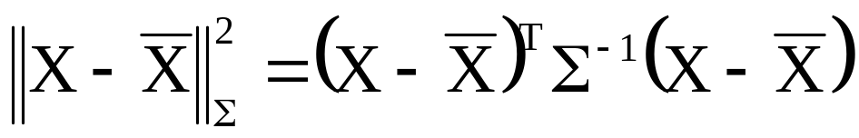
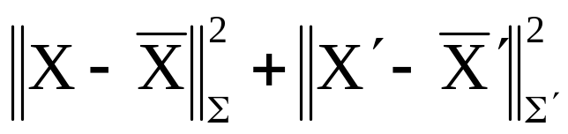
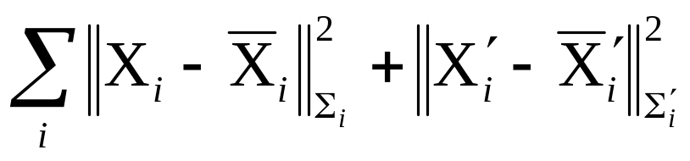
Mahalanobis distance
General Gaussian case
Measurement X with covariance matrix Σ
Error in two images (independent)
Varying covariances

Slide 11

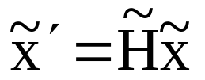


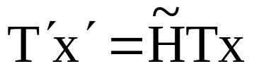
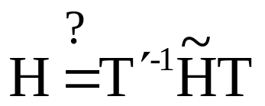
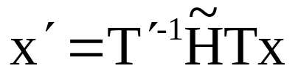
Invariance to transforms ?
will result change?
for which algorithms? for which transformations?

Slide 12



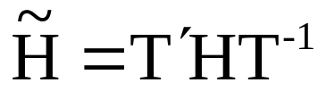
Non-invariance of DLT
Given and H computed by DLT,
and
Does the DLT algorithm applied to
yield ?

Slide 13
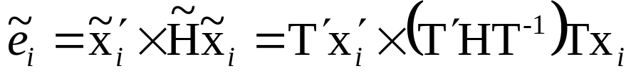
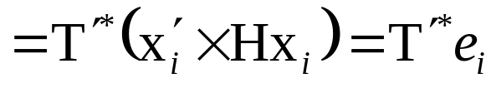
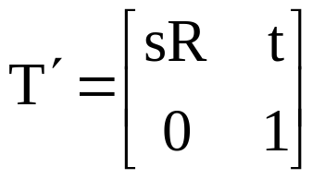
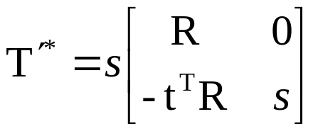
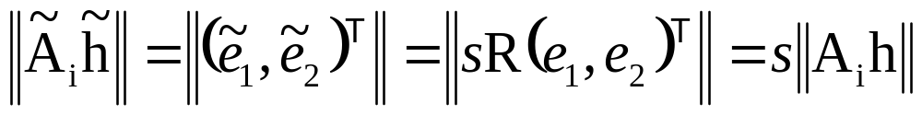
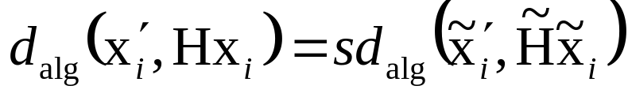
Effect of change of coordinates on algebraic error
for similarities
so

Slide 14
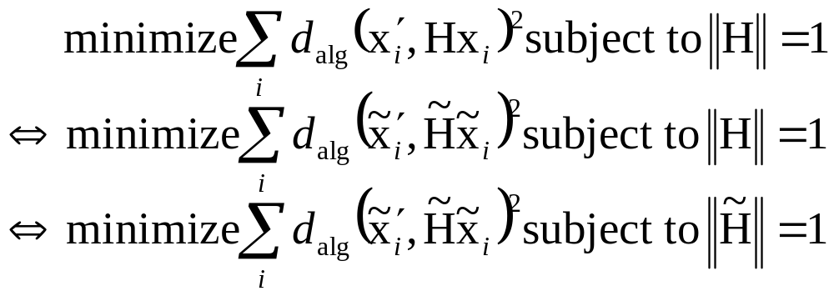
Non-invariance of DLT
Given and H computed by DLT,
and
Does the DLT algorithm applied to
yield ?

Slide 15


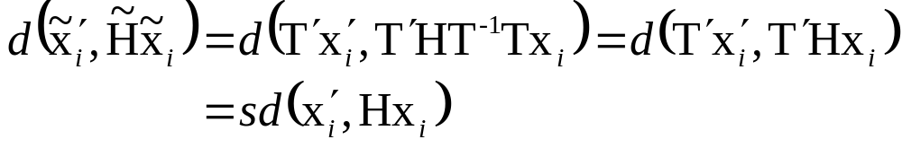
Invariance of geometric error
Given and H,
and
Assume T’ is a similarity transformations

Slide 16

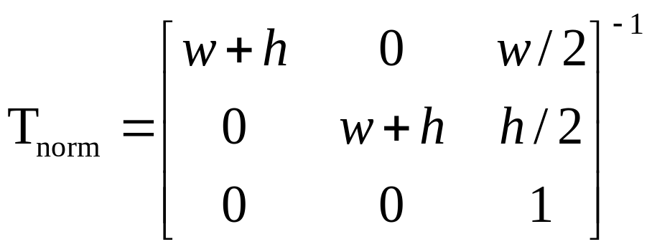
Normalizing transformations
Since DLT is not invariant,
what is a good choice of coordinates?
  e.g.
  Translate centroid to origin
  Scale to a average distance to the origin
  Independently on both images
Or

Slide 17
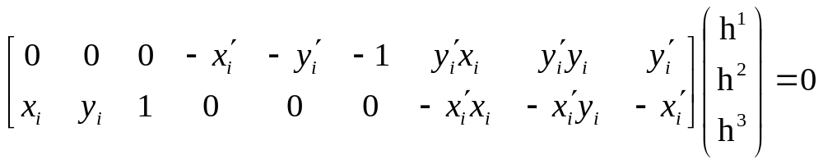
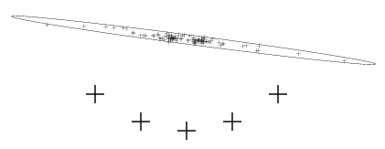
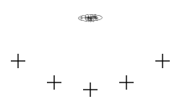
Importance of normalization
~10²
~10²
1
~10²
~10²
1
~10⁴
~10⁴
~10²
orders of magnitude difference!

Slide 18

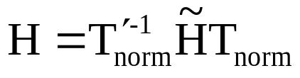
Normalized DLT algorithm
Objective
Given n≥4 2D to 2D point correspondences {x_{i}↔x_{i}’}, determine the 2D homography matrix H such that x_{i}’=Hx_{i}
Algorithm
Normalize points
Apply DLT algorithm to
Denormalize solution

Slide 19
Iterative minimization metods
Required to minimize geometric error
Often slower than DLT
Require initialization
No guaranteed convergence, local minima
Stopping criterion required
Therefore, careful implementation required:
Cost function
Parameterization (minimal or not)
Cost function ( parameters )
Initialization
Iterations

Slide 20
Parameterization
Parameters should cover complete space and allow efficient estimation of cost
  Minimal or over-parameterized? e.g. 8 or 9
  (minimal often more complex, also cost surface)
  (good algorithms can deal with over-parameterization)
  (sometimes also local parameterization)
  Parametrization can also be used to restrict transformation to particular class, e.g. affine

Slide 21
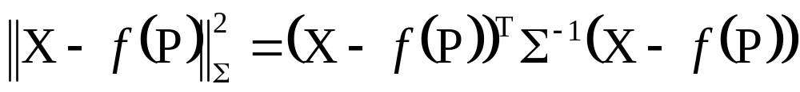

Function specifications
Measurement vector X∈^{N} with covariance Σ
Set of parameters represented by vector P ∈^{N}
Mapping f : ^{M} →^{N}. Range of mapping is surface S representing allowable measurements
Cost function: squared Mahalanobis distance
Goal is to achieve , or get as close as
possible in terms of Mahalanobis distance

Slide 22

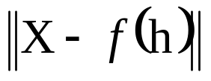
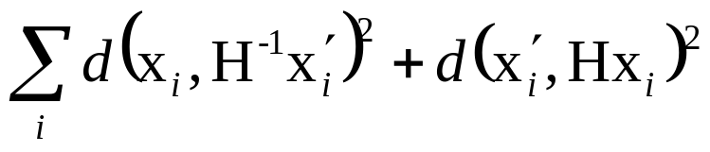

Error in one image
Symmetric transfer error
Reprojection error

Slide 23
Initialization
Typically, use linear solution
If outliers, use robust algorithm
Alternative, sample parameter space

Slide 24
Iteration methods
Many algorithms exist
Newton’s method
Levenberg-Marquardt
Powell’s method
Simplex method

Slide 25

Gold Standard algorithm
Objective
Given n≥4 2D to 2D point correspondences {x_{i}↔x_{i}’}, determine the Maximum Likelyhood Estimation of H
(this also implies computing optimal x_{i}’=Hx_{i})
Algorithm
Initialization: compute an initial estimate using normalized DLT or RANSAC
Geometric minimization of -Either Sampson error:
  ● Minimize the Sampson error
  ● Minimize using Levenberg-Marquardt over 9 entries of h
  or Gold Standard error:
  ● compute initial estimate for optimal {x_{i}}
  ● minimize cost over {H,x₁,x₂,…,x_{n}}
  ● if many points, use sparse method

Slide 26
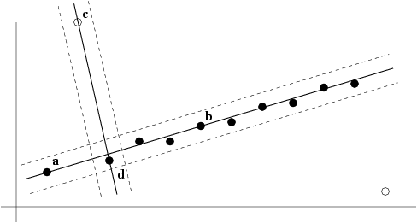
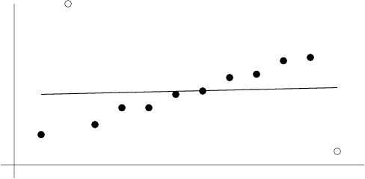
Robust estimation
What if set of matches contains gross outliers?

Slide 27
RANSAC
Objective
Robust fit of model to data set S which contains outliers
Algorithm
Randomly select a sample of s data points from S and instantiate the model from this subset.
Determine the set of data points S_{i} which are within a distance threshold t of the model. The set S_{i} is the consensus set of samples and defines the inliers of S.
If the subset of S_{i} is greater than some threshold T, re-estimate the model using all the points in S_{i} and terminate
If the size of S_{i} is less than T, select a new subset and repeat the above.
After N trials the largest consensus set S_{i} is selected, and the model is re-estimated using all the points in the subset S_{i}

Slide 28

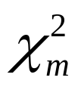
Distance threshold
Choose t so probability for inlier is α (e.g. 0.95)
Often empirically
Zero-mean Gaussian noise σ then follows
distribution with m=codimension of model
(dimension+codimension=dimension space)
Codimension | Model | t ²
1 | l,F | 3.84σ²
2 | H,P | 5.99σ²
3 | T | 7.81σ²

Slide 29
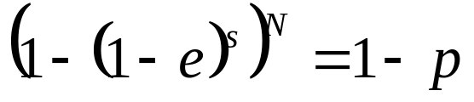
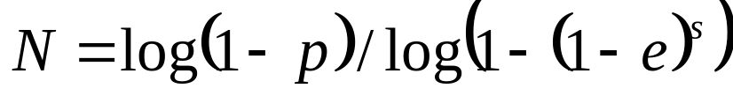
How many samples?
Choose N so that, with probability p, at least one random sample is free from outliers. e.g. p=0.99
 | proportion of outliers e
s | 5% | 10% | 20% | 25% | 30% | 40% | 50%
2 | 2 | 3 | 5 | 6 | 7 | 11 | 17
3 | 3 | 4 | 7 | 9 | 11 | 19 | 35
4 | 3 | 5 | 9 | 13 | 17 | 34 | 72
5 | 4 | 6 | 12 | 17 | 26 | 57 | 146
6 | 4 | 7 | 16 | 24 | 37 | 97 | 293
7 | 4 | 8 | 20 | 33 | 54 | 163 | 588
8 | 5 | 9 | 26 | 44 | 78 | 272 | 1177

Slide 30

Acceptable consensus set?
Typically, terminate when inlier ratio reaches expected ratio of inliers

Slide 31

Adaptively determining the number of samples
e is often unknown a priori, so pick worst case, e.g. 50%, and adapt if more inliers are found, e.g. 80% would yield e=0.2
  N=∞, sample_count =0
  While N >sample_count repeat
    Choose a sample and count the number of inliers
    Set e=1-(number of inliers)/(total number of points)
    Recompute N from e
    Increment the sample_count by 1
  Terminate

Slide 32
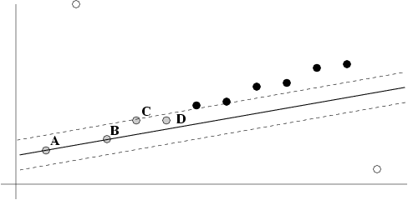
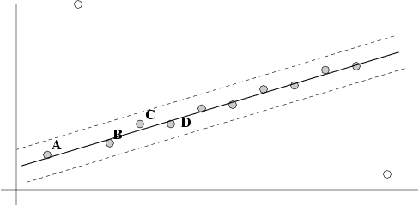
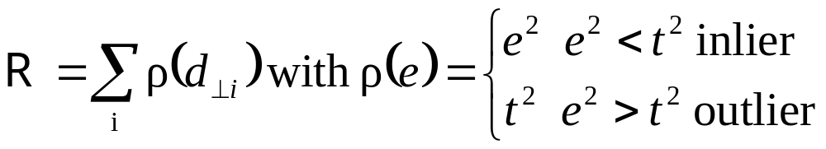
Robust Maximum Likelyhood Estimation
Previous MLE algorithm considers fixed set of inliers
Better, robust cost function (reclassifies)

Slide 33
Other robust algorithms
RANSAC maximizes number of inliers
LMedS minimizes median error
Not recommended: case deletion, iterative least-squares, etc.

Slide 34
Automatic computation of H
Objective
Compute homography between two images
Algorithm
Interest points: Compute interest points in each image
Putative correspondences: Compute a set of interest point matches based on some similarity measure
RANSAC robust estimation: Repeat for N samples
(a) Select 4 correspondences and compute H
(b) Calculate the distance d⊥ for each putative match
(c) Compute the number of inliers consistent with H (d⊥<t)
Choose H with most inliers
Optimal estimation: re-estimate H from all inliers by minimizing ML cost function with Levenberg-Marquardt
Guided matching: Determine more matches using prediction by computed H
Optionally iterate last two steps until convergence

Slide 35
Determine putative correspondences
Compare interest points
  Similarity measure:
  SAD, SSD, ZNCC on small neighborhood
If motion is limited, only consider interest points with similar coordinates
More advanced approaches exist, based on invariance…

Slide 36
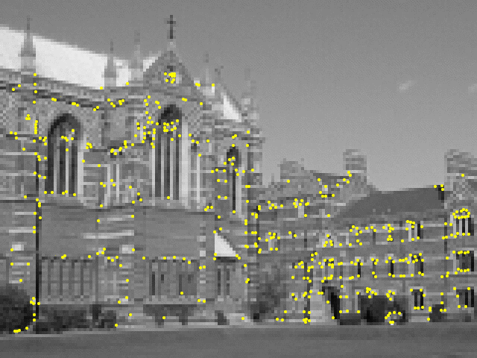
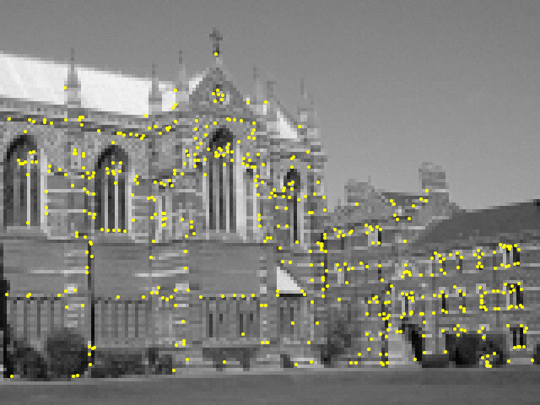
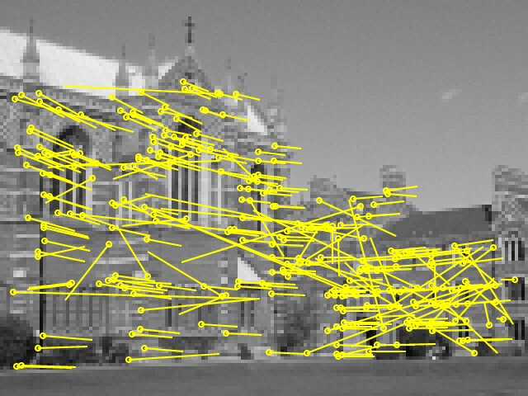
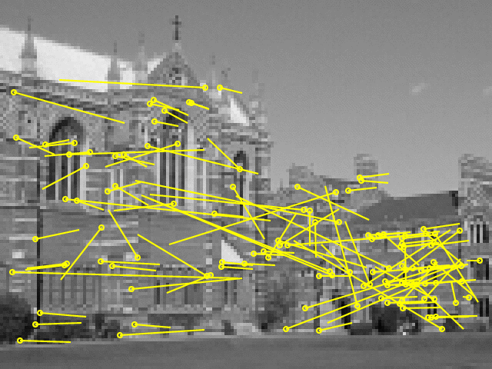
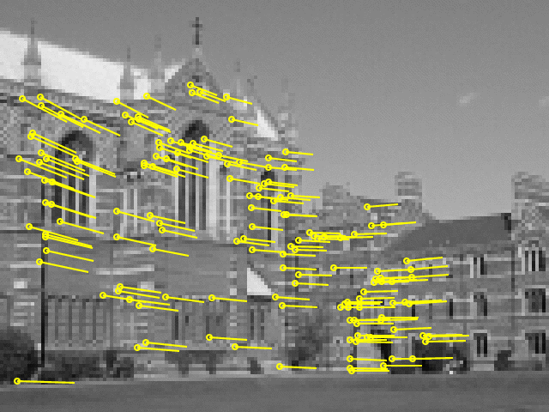

Example: robust computation
Interest points
(500/image)
Putative correspondences (268)
Outliers (117)
Inliers (151)
Final inliers (262)

Slide 37

Assignment
Take two or more photographs taken from a single viewpoint
Compute panorama
Use different measures DLT, MLE
Use Matlab
Due Feb. 13

Slide 38
Next class: Algorithm evaluation and error analysis
Bounds on performance
Covariance propagation
Monte Carlo covariance estimation

